Slide 1
Dan’s Hip Frappuccino Paradise Website
Group 3
Spencer Hall - Database Templar
Logan Nielsen - React Ninja
Justin Roylance - Backend Wizard
Gabe Tonks - Authentication Warrior

Slide 2
Project Overview: Tool Stack
Front End: React
Backend: Django
Database: SQLite
Project Management: GitHub and GitHub Projects
These are all tools that at least one or more members of our team had significant experience with and had plenty of documentation online to help fill in any gaps of our knowledge. These tools are very capable for building projects like this one and are very commonly used.

Slide 3
Project Overview: Agile and Scrum
Our team utilized the Agile development model and Scrum to increase performance and efficiency. We met at the beginning of every two-week sprint and held a planning session for the work to be done. We identified all tasks needed to be completed and assigned each task story points after a small discussion of the required work. These tasks were then divided up evenly to each team member based on their skillset.
Our team would then meetup 2-3 times throughout the week to follow up on the current status of these tasks and modify and/or add new tasks as needed after further discussion of the involved requirements and the current method of implementation.
At the conclusion of the sprint, we would meet again and discuss what went well and what could be improved during the next sprint. We found this approach to be very beneficial to our productivity.

Slide 4
Project Overview: Move into Deployment
Our project is now complete and ready to be deployed. The functionality of our code satisfies all the requirements defined in the requirements definition we created in the beginning with the customer.
We have given sufficient time to clean up and refactor the code and fix any bugs found. We have implemented several unit tests to verify the functionality of the core capabilities of the project and the correctness of the code. Sufficient end to end testing was also done following the use case diagrams’ event flow to verify these capabilities.

Slide 5
Place an Order: Requirements
Order Placement
All users must have the ability to place orders for themselves
Users should be able to customize orders
Requirement 3 and all of its sub-requirements in our Requirements Definition document relate directly to allowing customers to place and customize orders. We didn’t end up implementing requirement 3.2 because we could require customers to create an account and place orders directly through it. We did this primarily because of the short time frame we had for development, which required us to prioritize the most important aspects of the project.

Slide 6
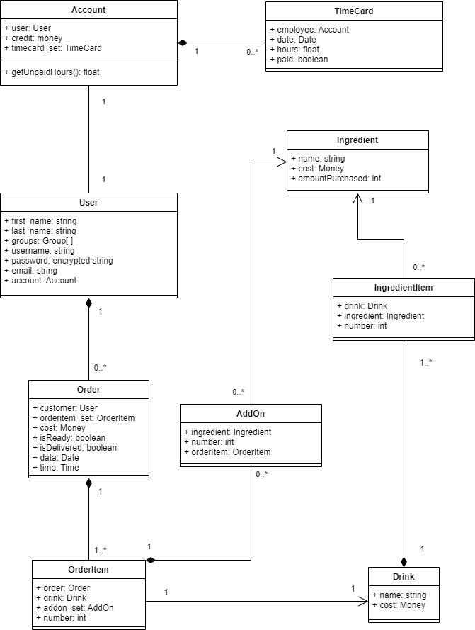
Place an Order: UML Class Diagrams
We primarily modeled our order placement requirement (requirement 3) during Milestone 2 by diagraming how the classes that we would need to keep track of orders relate to each other. The classes that are used while placing an order are the Order, OrderItem, AddOn, Ingredient, Drink, User, and Account classes.
The OrderItem class was not present in the first iteration of our class diagram. We added it during the implementation phase of the project because we needed a way for customers to be able to order more than one of the same drink (with all the same add-ons).

Slide 7
Place an Order: Implementation and Testing
The obvious aspects of the place an order requirements primarily implemented by Logan and Justin, with Logan working primarily on the frontend and Justin working primarily on the backend. Spencer also contributed significantly to this section by designing the database tables we need need in order to store and track orders.
Testing for the place an order requirements was primarily done using unit tests. Django has an integrated testing library that we used to write unit tests for major functionality related to placing an order such as verifying that orders are placed correctly and that funds are removed from the customer’s account and added to the manager’s account when an order is placed.

Slide 8


Slide 9
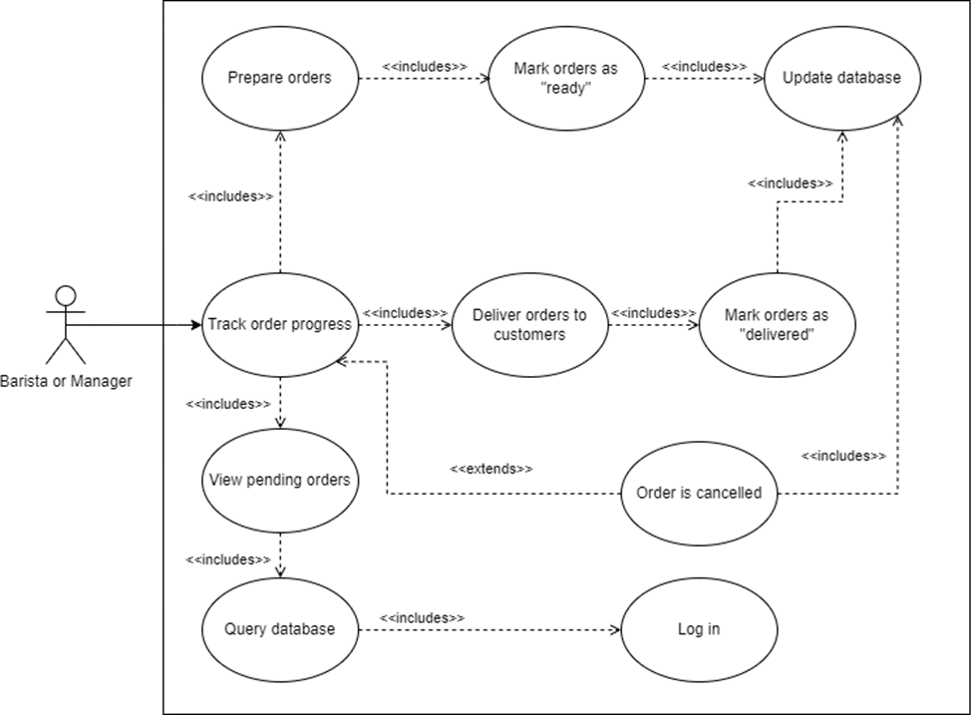
Manage Order
4. Order Management
4.1. Baristas and the manager must be able to manage orders.
4.1.1. Customers must not be able to manage orders.
4.3. Baristas and the manager must be able to mark orders as ready for pickup.
4.3.1. Customers must not be able to mark orders as ready for pickup.
4.4. Baristas and the manager must be able to mark orders as fulfilled.

Slide 10
Manage Order - Related Scrum Tasks
Create Database: Order
Create Database: Drink
Create Database: User
View order status page
Baristas and the manager must be able to manage orders

Slide 11
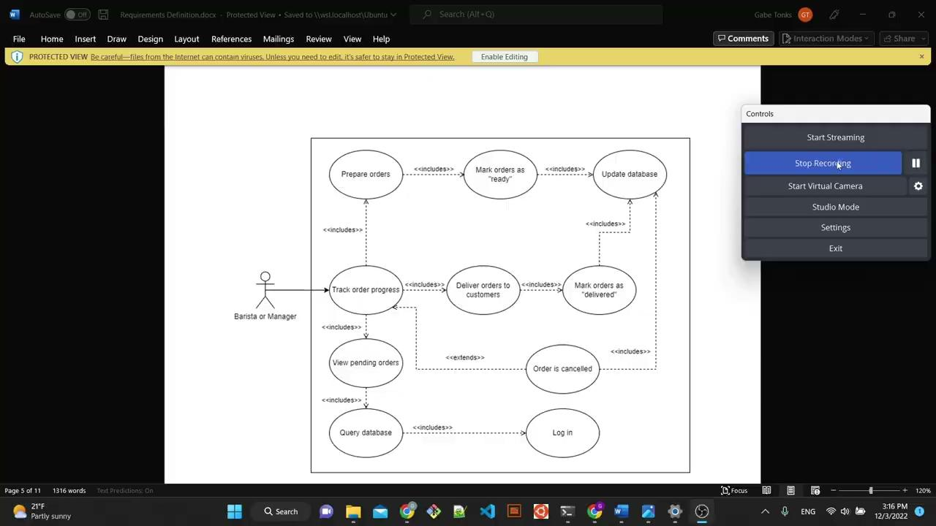
https://drive.google.com/file/d/1x3fMOdKC5CpeJpQbHcrjjdrhggF1R-GQ/view?usp=sharing

Slide 12
Inventory Management: Requirements Gathering
2.1.1. Inventory must decrease as products are used to fulfill orders.
2.1.1.1. Customers should not be able to place orders that cannot be fulfilled due to inventory shortages.
2.1.2. The manager must be able to buy and stock the inventory.
2.1.2.1. The manager should be able to view the current status of the inventory.
2.1.2.2. Customers and baristas should not be able to buy and stock the inventory.
2.1.3. The manager should be able to update menu information.
2.1.3.1. The manager should be able to add products to the menu.
2.1.3.2. The manager should be able to edit product names.
2.1.3.3. The manager should be able to edit prices.
2.1.3.4. The manager could be able to edit portion sizes.
All requirements in section 2 of our requirements gathering document pertain to the management of inventory. We were able to implement all of these requirements in our design except 2.1.3.4, since each of our drinks do not have differing portion sizes.

Slide 13
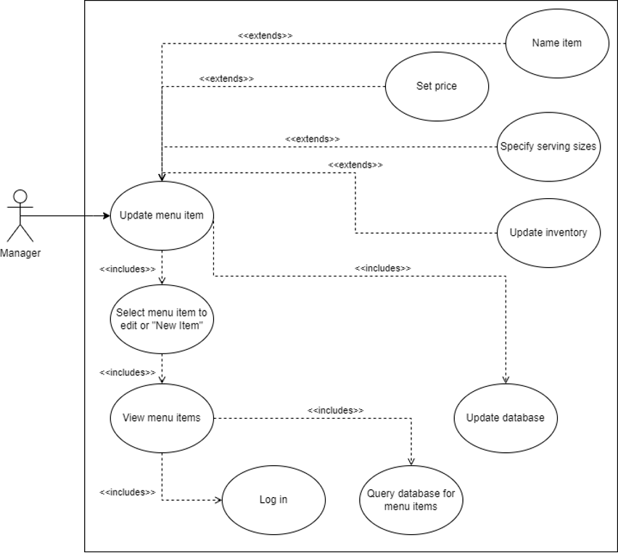
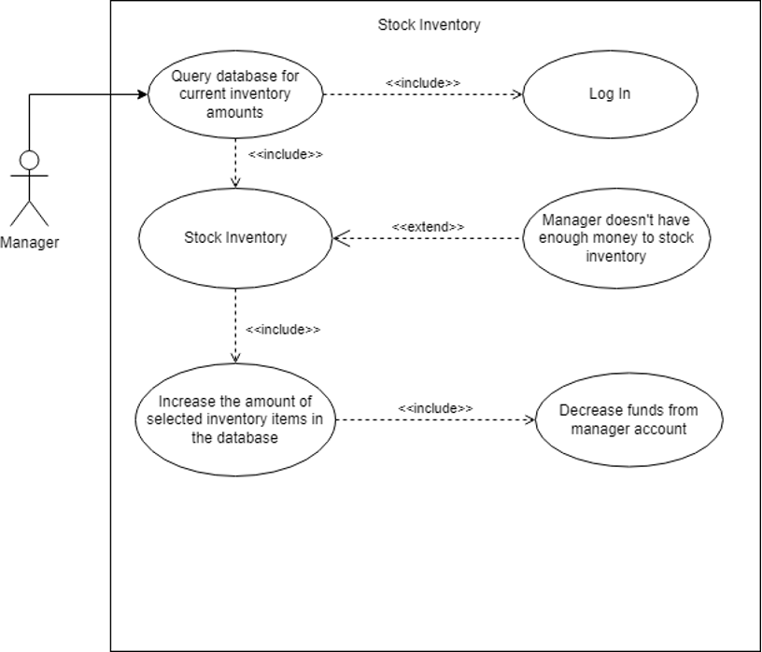
Inventory Management: Design
We created two use case diagrams for the different aspects of managing the inventory. Updating the menu and buying more. We drew heavily from these diagrams in the development of these features.

Slide 14
Inventory Management: Implementation & Testing
Scrum Tasks:
Create Ingredient Database
Create Drink Database
Create Updating Menu backend
Create Buying Inventory backend
Create Updating Menu Frontend
Create Buying Inventory Frontend
Implement Inventory Unit Tests
Given the simplicity django allows in updating and creating models, we divided the work on these features at a fairly high level. Each of these tasks was designated to take up only a couple hours time while maintaining a fully functional environment between the different kinds of objects involved. The development of some of these features was dependent on the development of the manager dashboard, which contained these amongst other manager capabilities, and was taken into account on our projected timeline.

Slide 15
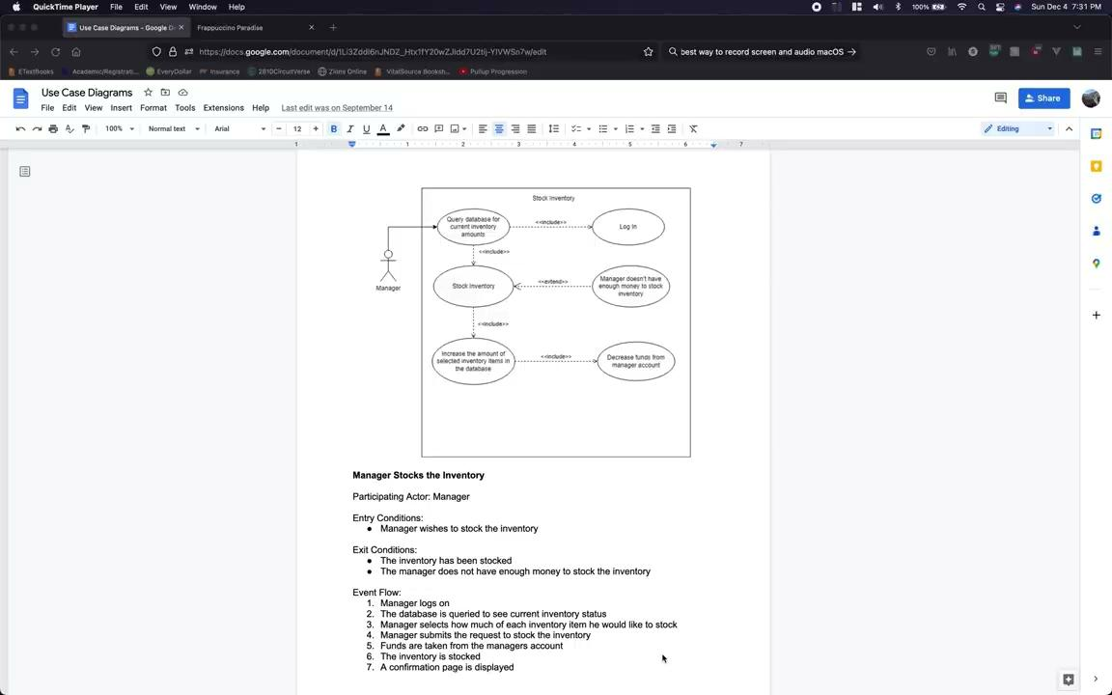

Slide 17
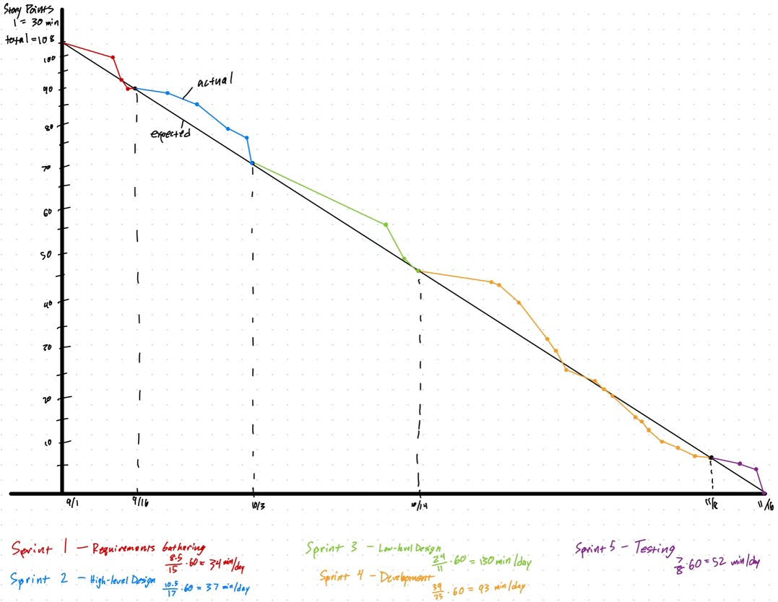
Burndown Chart

Slide 18
Questions?
https://docs.djangoproject.com/en/4.1/topics/auth/
https://developer.mozilla.org/en-US/docs/Learn/Server-side/Django/Authentication
https://mui.com/material-ui/getting-started/overview/
https://docs.djangoproject.com/en/4.1/intro/tutorial01/
https://reactjs.org/docs/state-and-lifecycle.html

